Slide 1
Where do we need to store the static files in ASP.NET Core?
What is wwwroot folder in ASP.NET Core?
How to Configure Static Files Middleware in ASP.NET Core Web Application?
How to use your own Webroot folder?
One of the most important features almost all web applications should have the ability to serve the static files directly from the file system. The static files such as HTML, Images, CSS, and JavaScript are the important assets of an application and ASP.NET Core can serve these files directly to the clients. But the important point that you need to keep in mind by default the ASP.NET Core cannot serve these static files. Some configuration is required in order to enable the ASP.NET Core to serve these static files directly.
Where do we need to store the static files in ASP.NET Core?
In ASP.NET Core Application, the default directory or location for the static files is wwwroot (webroot) folder and moreover, this folder or directory should be present in the project root folder. By default, this is the only place where the ASP.NET Core application can serve the static files directly. But we can change this default behavior by using the UseWebRoot method.
Note: If you create the project using a Web or MVC template then by default the wwwroot folder will be created by visual studio.

Slide 2
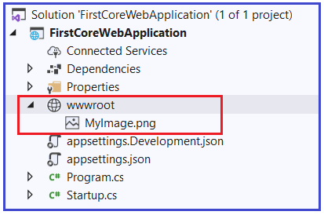

let’s add an Image file within wwwroot folder, folder. Please download and paste the following image into the wwwroot folder and modify the image name as MyImage.png.
Now run the application and navigate to the following URL. The point that you need to remember is you need to replace the port number on which your application is running.
http://localhost:<portnumber>/MyImage.png
When you navigate to the above URL, you will not get the output as expected, rather than you will get the following output.
The reason why we are not getting the output as expected because we don’t have any middleware which can serve the static files in the request processing pipeline.

Slide 3
How to Configuring the Static Files Middleware in ASP.NET Core Application?
In order to handle the static resources, we need to configure a middleware called UseStaticFiles() into the application request processing pipeline of an ASP.NET Core Application. The UseStaticFiles() middleware is an inbuilt middleware provided by ASP.NET Core Framework to handle the static files in an ASP.NET Core Application.
as shown below in order to add the UseStaticFiles() middleware to the request processing pipeline of the application.
if (env.IsDevelopment()) {
app.UseDeveloperExceptionPage();
}
//Adding Static Files Middleware to serve the static files
app.UseStaticFiles();
app.UseRouting();
app.UseEndpoints(endpoints => {
endpoints.MapGet("/", async context => {
await context.Response.WriteAsync("Hello World!");
});
}); } }
With the above changes in place, now run the application and navigate to the URL: http://localhost:<portnumber>/MyImage.png and you will see the output as expected a

